Slide 1

Human Activity Recognition
A ML approach to prediction the Human activity based on cell phone sensory data.

Slide 2
Data Background
Collected from 30 subjects, performing different activities with a smartphone to their waists.
Data is recorded with the help of sensors (accelerometer and Gyroscope) in that smartphone.
Data is collected from the http://archive.ics.uci.edu/ml/datasets/Smartphone-Based+Recognition+of+Human+Activities+and+Postural+Transitions# .

Slide 3
Data Background
For Each record it is provided
Triaxial acceleration from the accelerometer (total acceleration) and the estimated body acceleration.
Triaxial Angular velocity from the gyroscope.
A 563-feature vector with time and frequency domain variables.
Its activity label.

Slide 4
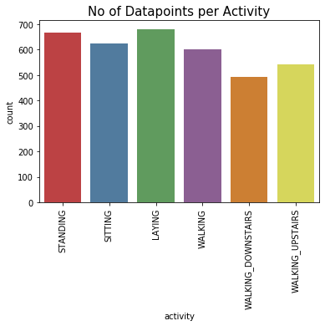
Data Spread of Target Variable
All the activities have data count in rage from 500-700.
Data spread can be termed as balanced data

Slide 5
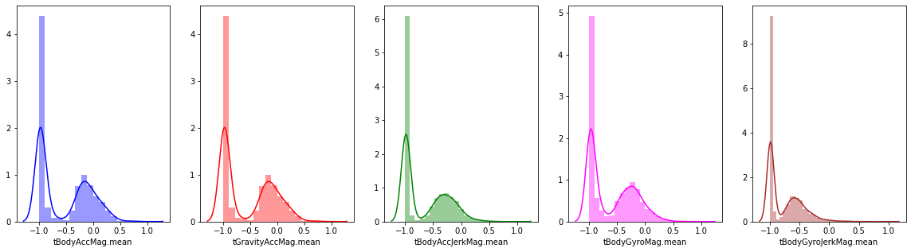
Data Distribution of Few Features.

Slide 6
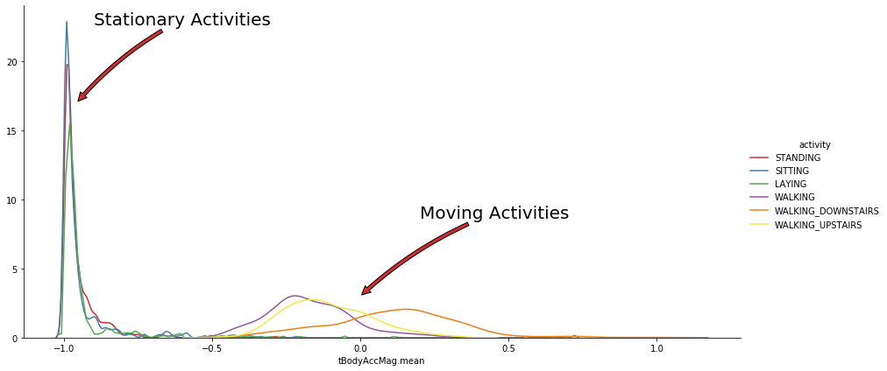
Explore few Features
tBodyAccMag.mean indicates that mostly two type of movement is performed.
Stationary and Moving.
Moving activities are Walking, Walking upstairs and downstairs.
Stationary activities are Standing, Sitting and Laying.

Slide 7
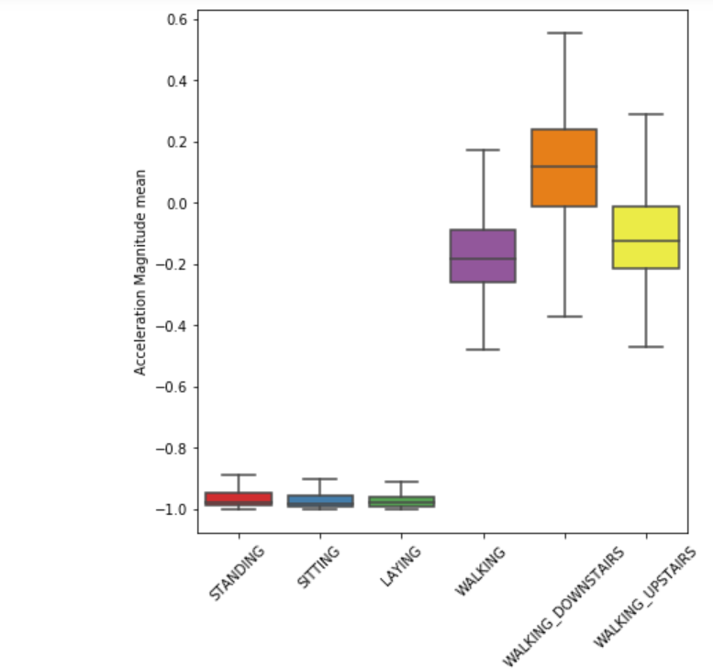
Stationary and Moving Activity
If tAccMean is < -0.8 then the Activities are either Standing or Sitting or Laying.
If tAccMean is > -0.6 then the Activities are either Walking or WalkingDownstairs or WalkingUpstairs.
If tAccMean > 0.0 then the Activity is WalkingDownstairs.

Slide 8
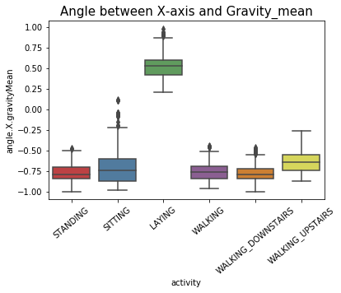
Position of Gravity Acceleration component
If angle.X.gravityMean > 0 then Activity is Laying.

Slide 9
ML Training Process
Data Standardization
Data Split into Train and Test set
Model Fitting with various Classification approach.

Slide 10
List of classification approaches Used
Logistic Regression
Decision Tree Classification
Random Forest Classifier
Linear SVM
SVM (Radial)
Naive Bayes
K Nearest Neighbors

Slide 11
Random Forest : Classification Report
 | precision | recall | f1-score | support
LAYING | 1.00 | 1.00 | 1.0 | 152
SITTING | 0.95 | 0.94 | 0.94 | 132
STANDING | 0.93 | 0.94 | 0.94 | 118
WALKING | 0.98 | 0.98 | 0.98 | 126
WALKING_DOWNSTAIRS | 0.98 | 0.95 | 0.96 | 97
WALKING_UPSTAIRS | 0.95 | 0.97 | 0.96 | 97
accuracy |  |  | 0.97 | 722
macro avg | 0.96 | 0.96 | 0.96 | 722
weighted avg | 0.97 | 0.97 | 0.97 | 722

Slide 12
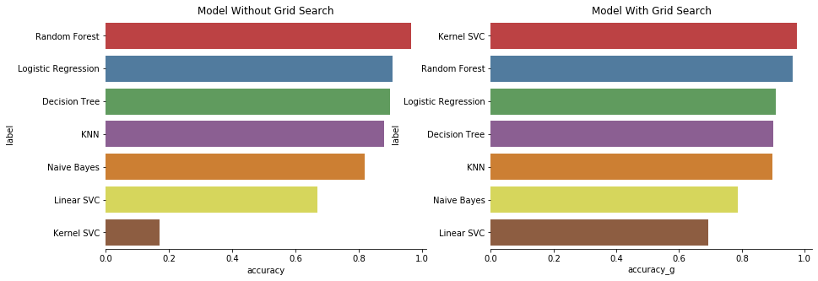
Model Evaluation
Random Forest Classifier is giving best result among different models.
It has accuracy close to 96.5%.
Kernel SVC is giving best result with grid search (Hyperparameter Tuning).
It has accuracy close to 97.5%.

Slide 13
Feature Selection
Variance Threshold function is used to reduce the feature,
This function removes the all low variance features.
It is the unsupervised approach to reduce the dimensions.
93 features selected out of 562 after applying this method.

Slide 14
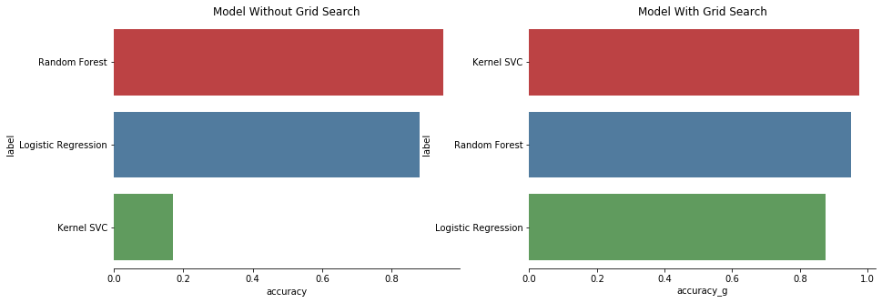
Model Evaluation after FEATURE SELCTION
For Random forest classifier there is not improvement after feature selection process.
For Kernel SVM also there is not much improvement with Grid Search approach.

Slide 15
CONCLUSION
Random Forest Classification without Grid search tuning is the best model to predict the activity on new dataset.
With Grid Search Tuning Kernel SVM is the best model to predict activities.
There is not much improvement after feature selection on both the models.

